Slide 1
CSS Box Model

Slide 2
AGENDA
Writing Semantic HTML5
Block Level Elements / Inline Level Elements
CSS Reset & Normalization
Box Model : border-box
CSS Debugging in DevTools

Slide 3
1. Writing Semantic HTML

Slide 4
HTML Syntax

Slide 5
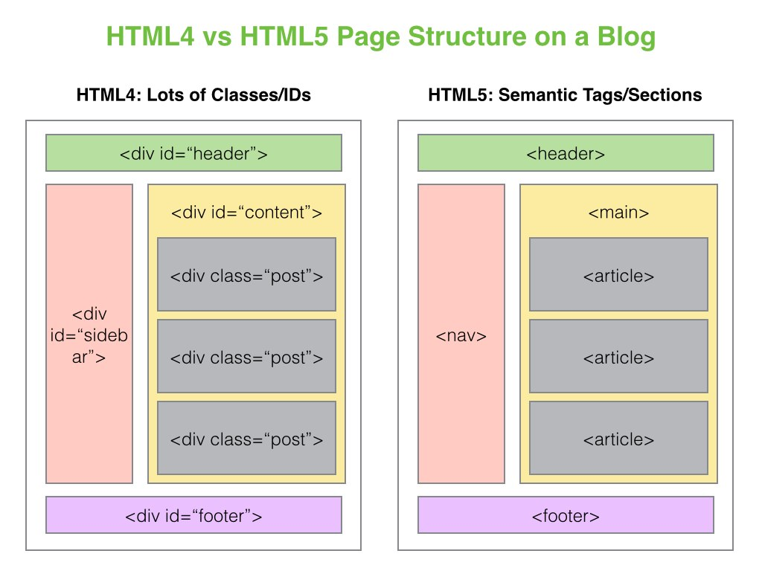
Semantic HTML5

Slide 6
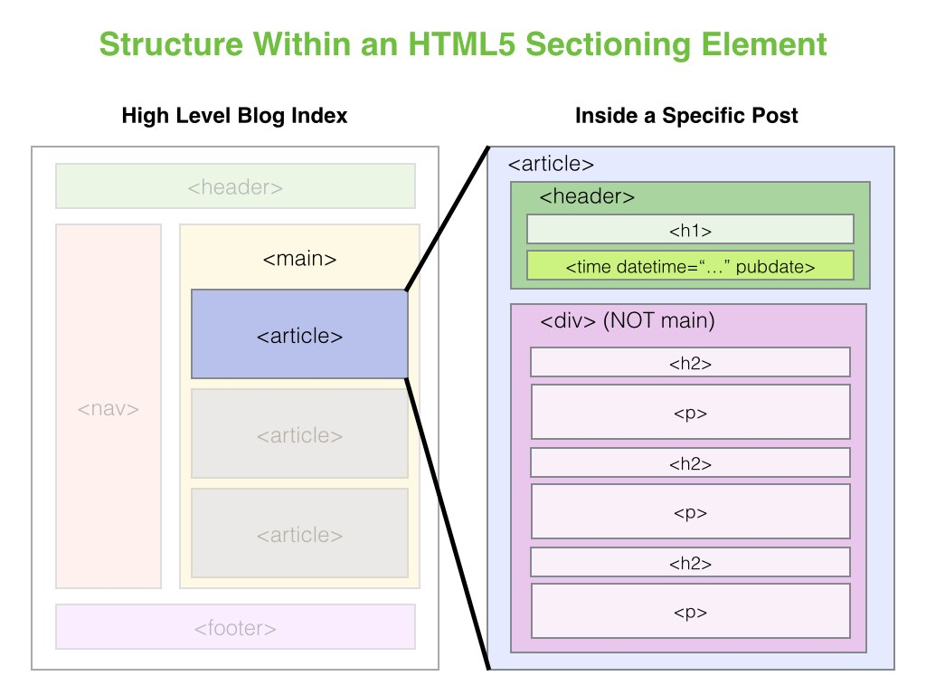
Semantic HTML

Slide 7
2. Block Level Elements / Inline Level Elements

Slide 8
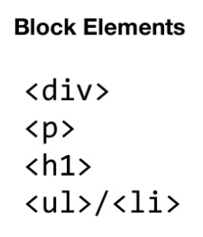
Block Level Elements

Slide 9
3. CSS Normalization & Reset

Slide 10
Normalizing CSS

Slide 11
4. Box Model

Slide 12
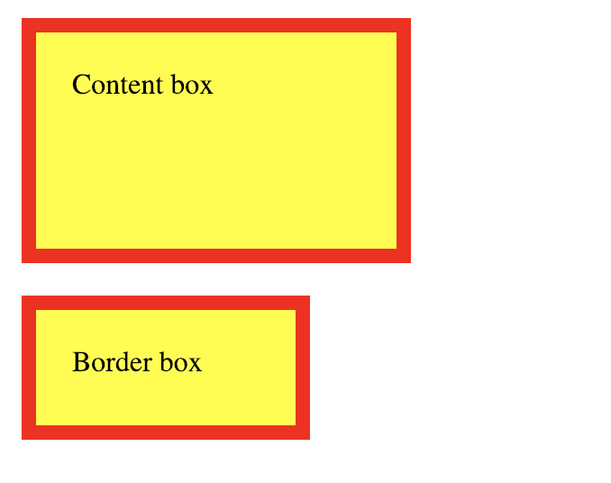
Box Model

Slide 13
5. CSS Debugging in Dev Tools

Slide 14
6. Other Topics

Slide 15
Other Topics
Bootstrap (CSS/UI grid frameworks)
CSS Preprocessors (SCSS)
Flexbox (CSS3 web layout model)

